Slide 1
HIPAA
Health Insurance Portability and Accountability Act

Slide 2
HIPAA
Federal law passed by Congress in 1996
Regulations promulgated by the Dept of Health and Human Services
Guidelines implemented in April, 2003

Slide 3
HIPAA
HIPAA regulations were designed to:
protect individuals’ rights to privacy and confidentiality
And
2) assure the security of electronic transfer of personal information

Slide 4
HIPAA ….. Need?
An Atlanta truck driver lost his job in early 1998 after his employer learned from his insurance company that he had sought treatment for a drinking problem.
The late tennis star Arthur Ashe’s positive HIV status was disclosed by a healthcare worker and published by a newspaper without his permission.
Tammy Wynette’s medical records were sold to National Enquirer by a hospital employee for $2,610.

Slide 5
HIPPA…. Need?
Genetic advancements - as more is known about our genetic predisposition to diseases, HIPAA will ensure that, for example, an individual is not denied insurance because the company knows that she may eventually develop some diseases.
Marketing - as information is more easily captured concerning, for example, the prescriptions we purchase, HIPAA is designed to prevent marketing of unsolicited products or services based on harvested marketing data.
Technology - as information is quickly and sometimes loosely moved around networks, HIPAA standards will hold violators accountable for accidental or intentional ‘interception’ of protected health information (PHI).

Slide 6
HIPPA
Health information is used by multiple agents in the course of a single episode with a health problem.
Below are some of the agencies and individuals who may handle health information.
  Admitting clerks
  Caregivers from the ED to the morgue
  Physical therapists
  Nutritionists
  Lab personnel
  Receptionists in MD offices
  Transport techs
  Respiratory therapists
  Billing clerks
  Insurance agents/clerks
  School teachers/nurses
  Home health personnel
  Medical records clerks
  Website managers

Slide 7
HIPPA
Give patients more control over their health information.
Set boundaries on the use and disclosure of health records.
Establish appropriate safeguards for all people who participate in or are associated with the provision of healthcare to ensure that they honor patients’ rights to privacy of their PHI.
Hold violators accountable through civil and criminal penalties.
Strike a balance when public responsibility requires disclosure of some forms of data--for example, to protect public health.

Slide 8
HIPPA
Protected Health Information (PHI) or Protected Medical Information (PMI) This is any data about the patient that would tend to identify the individual: name, hospital #, diagnosis, lab results, past or current photos, etc, etc.
Privacy Officer (PO) Each facility will have an employee who is responsible for implementing and enforcing this law.
Covered Entity (CE) This includes any health plan, healthcare provider, agency that processes claims, and any company that subcontracts with them are covered by this law.

Slide 9
HIPPA
Release/Disclosure These are terms used in describing the release of PHI to other CEs for TPO(treatment. payment, or health care operations).
Accounting of Disclosure (AOD) The patient has the right to have an AODs for his PHI or PMI.
Directory This is CE’s census or list of patients used by volunteers and operators to direct visitors.

Slide 10
HIPPA
Individuals have the right to:
Receive notice of an agency’s privacy practices.
Know that an agency will use its PHI ONLY for treatment, payment, operations (TPO), certain other permitted uses and uses as required by law
Consent to and control the use and disclosure of their PHI.

Slide 11
HIPPA
Access their protected health information (PHI), except for psychotherapy notes (they might be charged for copies)
Request amendment or addendum to their PHI (not always granted)
Receive accountings of disclosures
File privacy complaints to agency officer

Slide 12
HIPPA … Best practices followed
Personal information cannot be released to individuals or companies interested in marketing ventures, without the patient’s written permission. For example:
  Names of patients on antihypertensive drugs cannot be released to a company marketing nutritional products to lower blood pressure.
  Names and addresses of pregnant women cannot be provided to infant formula companies.
  Contact information of previous patients cannot be used to raise money for a hospital building campaign.

Slide 13
HIPPA … Best practices followed
PHI should be shared with as few individuals as needed to ensure patient care and then only to the extent demanded by the individual’s role.
Take all reasonable steps to make sure that individuals without the ‘need to know’ do not overhear conversations about PHI.
DO NOT conduct discussion about PHI in elevators or cafeterias.
Do not let others see your computer screen while you are working. Be sure to log out when done with any computer file.

Slide 14
HIPPA … Best practices followed
identify the patient/client by initials only
protect the computer screen, PDA, clip board, or notes from other individuals who don’t have a ‘need to know’
protect your printer output from others who don’t have a ‘need to know’
protect your floppy/zip/CD-ROM/PDA from loss
NOT to photoduplicate or fax patient documents in the process of working with your patient’s PHI.

Slide 15
HIPPA
DO NOT put notes with PHI/PMI in the trash or paper recycle cans.
A paper shredder shall be used to destroy above papers.
Penalties
Legal consequences
  Civil or criminal penalties
  Fines plus imprisonment
Professional consequences:
  Disciplinary action by the respective Boards

Slide 16
The Systems Security Engineering Capability Maturity Model

Slide 17
Topics
SSE-CMM Project
History & the Need
SSE-CMM Overview
Using the SSE-CMM
SSE-CMM Pilots

Slide 18
Why was the SSE-CMM developed?
Objective
advance security engineering as a defined, mature, and measurable discipline
Project Goal
Develop a mechanism to enable:
  selection of appropriately qualified security engineering providers
  focused investments in security engineering practices
  capability-based assurance
Why the CMM approach?
accepted way of improving process capability
increasing use in acquisition as indicator of process capability

Slide 19
Project Structure
Steering Group
  Provides project direction and strategy
  Reviews and approves release of work products
Project
Leader
Reviewers
  Provide expert review of project materials
Model Maintenance
Working Group
Appraisal Method
Working Group
Profiles/Metrics/Assurance
Working Group
Life Cycle Support
Working Group
Sponsorship/Adoption
Working Group
Original work and project infrastructure sponsored by NSA; additional support provided by OSD and Communications Security Establishment (Canada)
Collaborative effort by industry and government on their own funding

Slide 20
Project Participants
Arca Systems, Inc.
BDM International Inc.
Booz-Allen and Hamilton, Inc.
Canadian Communications Security Establishment
Computer Sciences Corporation
Data Systems Analysts, Inc.
Defense Information Systems Agency
E-Systems
Electronic Warfare Associates - Canada, Ltd.
Fuentez Systems Concepts
G-J Consulting
GRC International, Inc.
Harris Corp.
Hughes Aircraft
Institute for Computer & Information Sciences
Institute for Defense Analyses
Internal Revenue Service
ITT Aerospace
Lockheed Martin
Merdan Group, Inc.
MITRE Corporation
Mitretek Systems
Motorola
National Center for Supercomputing Applications
National Institute for Standards and Technology
National Security Agency
Naval Research Laboratory
Navy Command, Control, Operations Support Center; Research, Development, Testing, and Evaluation Division (NRaD)
Northrop Grumman
NRaD
Office of the Secretary of Defense
Oracle Corporation
pragma Systems Corp.
San Antonio Air Logistics Center
Science Applications International Corp.
SPARTA, Inc.
Stanford Telecom
Systems Research & Applications Corp.
Tax Modernization Institute
The Sachs Groups
tOmega Engineering
Trusted Information Systems
TRW
Unisys Government Systems

Slide 21
Project History
January 95 1st Public Workshop
Working Groups Formed
Summer/Fall 96 SSE-CMM Pilots
October 96 SSE-CMM v1.0
Early SSE-CMM Pilot Results
Spring 97 Appraisal Method v1.0
Summer 97 SSE-CMM v1.1
Appraisal Method v1.1
Pilot Results
14-17 July 97 2nd Public Workshop

Slide 22
Current Activities
The Model
  currently reviewing security risk analysis Process Areas
The Appraisal Method
  updating to accommodate 3rd party capability evaluations (available May 1999)
The Project
  planning for transition to consortium (July 1999)

Slide 23
Points of Contact
Project Sponsor:
  Mary Schanken
  NSA, V243
  410-859-6094
  schanken@romulus.ncsc.mil
Steering Group:
  Dan Gambel
  Mitretek Systems
  703-610-1598
  dgambel@erols.com
Model Maintenance:
  Jeff Williams
  Arca Systems, Inc.
  703-734-5611
  williams@arca.com
Appraisal Method:
  Mal Fordham
  IIT Research Institute
  301-918-1022
  mfordham@atg.iitri.com
Sponsorship/Adoption:
  Jim Robbins
  EWA Canada, Ltd.
  613-230-6067 ext. 216
  jrobbins@ewa-canada.com
Life Cycle Support:
  Virgil Gibson
  Computer Sciences Corp.
  410-684-6325
  vgibson1@csc.com
Profile/Metrics/Assurance:
  George Jelen
  G-J Consulting
  301-384-5296
  gjelen@erols.com
Web site: http://www.sse-cmm.org

Slide 24
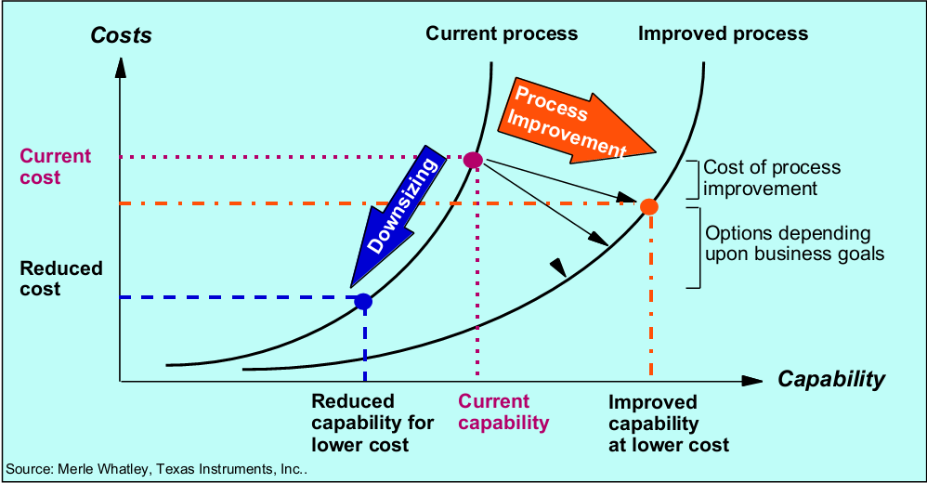
How SSE-CMM Helps????

Slide 25
Benefits of using CMM
Include definition and description of the applicable domain (e.g. systems engineering, software, etc.)
Lead to better processes & better products
Provide the data necessary for effective management of process improvement efforts
Strong return on investment

Slide 26
What is SSE-CMM?
Describes the essential systems security engineering and management tasks that any organization must perform
Road map for systems security engineering & management process improvement
Systems security engineering and management process measurement tool

Slide 27
What is SSE-CMM?
Tool for engineering organizations to evaluate security engineering practices and define improvements to them.
Standard mechanism for customers to evaluate a provider's security engineering capability.
Basis for security engineering evaluation organization (e.g., system certifiers and product evaluators) to establish organization capability-based confidences (as an ingredient to system or project security assurance).

Slide 28
What is security engineering?
Security engineering, or aspects thereof, attempts to:
  establish a balanced set of security needs
  transform security needs into security guidance
  establish confidence in the correctness and effectiveness of security mechanisms
  judge that operational impacts due to residual security vulnerabilities are tolerable
  integrate all aspects into a combined understanding of the trustworthiness of a system

Slide 29
Where are we now?
Security products come to market through:
  lengthy and expensive evaluation
  no evaluation
Results:
  technology growth more rapid than its assimilation
  unsubstantiated security claims

Slide 30
What is needed?
continuity
repeatability
efficiency
assurance

Slide 31
SSE-CMM Model Architecture
(based on SE-CMM Architecture)
Domain
Capability
Domain
Organization
Continuously Improving
Project
Quantitatively Controlled
Security Engineering
Well Defined
Process Areas
Planned & Tracked
Performed
Initial
Process
Areas
Capability Levels
Common
Features
Process
Areas
•
•
•
Process
Areas
•
Common
Features
•
•
•
•
•
Base
Practices
Base
Practices
Base
Practices
Generic
Practices
Base
Practices
Base
Practices
Base
Practices
Generic
Practices
10/24/96

Slide 32
Capability Levels and Common Features
  0 INITIAL
  1 PERFORMED INFORMALLY
    Base practices performed
  2 PLANNED & TRACKED
    Planning performance
    Disciplined performance
    Verifying performance
    Tracking performance
  3 WELL-DEFINED
    Defining a standard process
    Perform the defined process
    Coordinate practices
  4 QUANTITATIVELY CONTROLLED
    Establishing measurable quality goals
    Objectively managing performance
  5 CONTINUOUSLY IMPROVING
    Improving organizational capability
    Improving process effectiveness
Note: Capability Levels and Common Features are taken from the SE-CMM;
Italics indicate SSE-CMM additional Common Feature

Slide 33
Security Engineering Process Areas
Administer System Security Controls
Assess Operational Security Risk
Attack Security
Build Assurance Argument
Coordinate Security
Determine Security Vulnerabilities
Monitor System Security Posture
Provide Security Input
Specify Security Needs
Verify and Validate Security

Slide 34
Basis for Engineering Process Areas
(Security Engineering Providers)
Applicable Source
Provider with Security Engineering Activities
Products
Systems
Services
Independent Security Verification and Validation
X
Operational Risk (Threat, Weaknesses, Impact) Analysis -
X
X
Development
Operational Risk (Threat, Weaknesses, Impact) Analysis -
X
Post Development (AKA Security Audits)
Product Vendor (of a standard product with security features
)
X
Security Penetration Testing
X
X
X
Security Requirements & (High-Level) Architecture Resolution
X
X
X
Security Design & Implementation Guidance
X
Security Design & Implementation
X
X
Security Testing & Integration Guidance
Ã
Security Testing & Integration
X
X
Security Product Vendor (including Security Device Vendor)
X
System Weakness (Attack, Vulnerability, Impact) Analysis -
X
X
X
Development
System Weakness (Attack, Vulnerability, Impact) Analysis -
X
from:
“SSE-CMM Model and Application Report”
October 2, 1995
Post Development
Trusted Product Vendor
X
Trusted Software/Applications Developer
X
X
X

Slide 35
Administer System Security Controls
Goals:
  Security controls are properly configured and used
Base Practices:
  Establish security responsibilities
  Manage security configuration
  Manage security awareness, training, and education programs
  Manage security services and control mechanisms

Slide 36
Assess Operational Security Risk
Goals:
  An understanding of the security risk associated with operating the system within a defined environment is reached
Base Practices:
  Select risk analysis method
  Prioritize operational capabilities and assets
  Identify threats
  Assess operational impacts

Slide 37
Attack Security
Goals:
  System vulnerabilities are identified and their potential for exploitation is determined.
Base Practices:
  Scope attack
  Develop attack scenarios
  Perform attacks
  Synthesize attack results

Slide 38
Build Assurance Argument
Goals:
  The work products and processes clearly provide the evidence that the customer’s security needs have been met.
Base Practices:
  Identify assurance objectives
  Define assurance strategy
  Control assurance evidence
  Analyze evidence
  Provide assurance argument

Slide 39
Coordinate Security
Goals:
  All members of the project team are aware of and involved with security engineering activities to the extent necessary to perform their functions.
  Decisions and recommendations related to security are communicated and coordinated.
Base Practices:
  Define coordination objectives
  Identify coordination mechanisms
  Facilitate coordination
  Coordinate security decisions and recommendations

Slide 40
Determine Security Vulnerabilities
Goals:
  An understanding of system security vulnerabilities is reached.
Base Practices:
  Select vulnerability analysis method
  Analyze system assets
  Identify threats
  Identify vulnerabilities
  Synthesize system vulnerability

Slide 41
Monitor System Security Posture
Goals:
  Both internal and external security related events are detected and tracked.
  Incidents are responded to in accordance with policy.
  Changes to the operational security posture are identified and handled in accordance with security objectives.
Base Practices:
  Analyze event records
  Monitor changes
  Identify security incidents
  Monitor security safeguards
  Review security posture
  Manage security incident response
  Protect security monitoring artifacts

Slide 42
Provide Security Input
Goals:
  All system issues are reviewed for security implications and are resolved in accordance with security goals.
  All members of the project team have an understanding of security so they can perform their functions.
  The solution reflects the security input provided.
Base Practices:
  Understand security input needs
  Determine constraints and considerations
  Identify security alternatives
  Analyze security of engineering alternatives
  Provide security engineering guidance
  Provide operational security guidance

Slide 43
Specify Security Needs
Goals:
  A common understanding of security needs is reached between all applicable parties, including the customer.
Base Practices:
  Gain an understanding of customer security needs
  Identify applicable laws, policies, standards, and constraints
  Identify system security context
  Capture security view of system operation
  Capture security high-level goals
  Define security related requirements
  Obtain agreement on security

Slide 44
Verify and Validate Security
Goals:
  Solutions meet security requirements
  Solutions meet the customer’s operational security needs.
Base Practices:
  Identify verification and validation targets
  Define verification and validation approach
  Perform verification
  Perform validation
  Provide verification andvalidation results

Slide 45
Project/Organization PAs
(based on SE-CMM with Security Considerations)
Project
Ensure Quality
Manage Configurations
Manage Program Risk
Monitor and Control Technical Effort
Plan Technical Effort
Organization
Define Organization’s Security Engineering Process
Improve Organization’s Security Engineering Process
Manage Security Product Line Evolution
Manage Security Engineering Support Environment
Provide Ongoing Skills and Knowledge
Coordinate with Suppliers

Slide 46
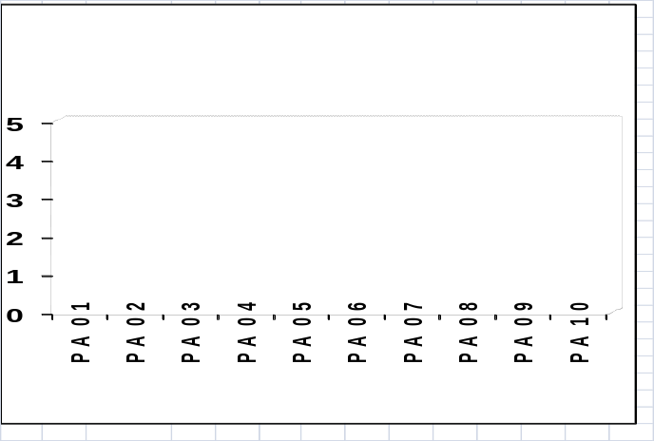
Appraisal Results: a Rating Profile
Domain Aspect
Base Practices
Base Practices
Base Practices
Base Practices
Base Practices
Base Practices
Process Areas
Process Areas
Process Areas
Process Areas
Process Category
Capability Aspect
Generic
Practices
Generic
Practices
Common
Features
Generic
Practices
Common
Features
Capability
Level
Generic
Practices
Common
Features
Generic
Practices
Generic
Practices

Slide 47
The Appraisal Process
(based on the SE-CMM Appraisal Method)
On-Site Phase
Post-Appraisal
Phase
Orient/Train Participants
Preparation
Phase
Interview Leads/ Practitioners
Report Lessons Learned
Obtain Sponsor Commitment
Establish Findings
Report Appraisal Outcomes
Review Findings w/Leads
Scope Appraisal
Refine Findings
Manage Appraisal Artifacts
Plan Appraisal
Develop Rating Profile
Collect Data
Report Results
Develop Findings and Recommendations Report
Analyze Questionnaire
Adjust Results
Wrap up

Slide 48



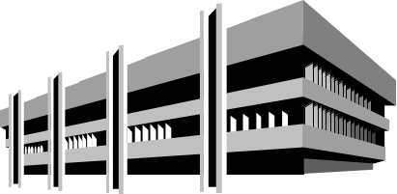



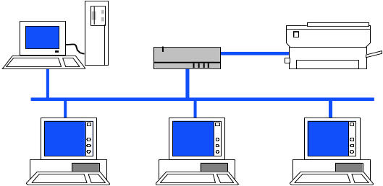

Using the SSE-CMM
Source Selection
System Development
HW Vendor
Services
Security Assessment
SW Vendor
SSE-CMM
Operation and Maintenance

Slide 49
Use by Engineering Organizations
Define processes / practices
Use for competitive edge (in source selections)
Focus improvement efforts
Issues
  big investment
  requires commitment at all levels
  need to interpret PAs in the organization’s context

Slide 50
Use by Acquirers
Standard RFP language and bidder evaluation
Understanding programmatic risks
Avoid protests (uniform assessments)
Greater level of confidence in end results
Issues
  doesn’t guarantee good results
  need to ensure uniform appraisals
  need good understanding of model and its use

Slide 51
Use by
Security Evaluation Organizations
Alternative to extensive evaluation/re-evaluation
  confidence in integration of security engineering with other disciplines
  confidence in end results
Issues
  doesn’t guarantee good results
  need to ensure uniform appraisals
  need good understanding of model and its use
  doesn’t eliminate need for testing/evaluation
  how does it actually contribute to assurance

Slide 52
PCI-DSS

Slide 53
What is PCI-DSS?
PCI-DSS stands for Payment Card Industry Data Security Standard
This is commonly called “PCI”
PCI is a council created by American Express, Discover Financial Services, JCB International, MasterCard Worldwide and Visa Inc International

Slide 54
Who Must Comply with PCI?
All merchants, whether small or large, need to be PCI compliant.
The payment brands have collectively adopted PCI DSS as the requirement for organizations that process, store or transmit payment cardholder data.

Slide 55
History of PCI
PCI was formed in order to make compliance simpler
Up until 2004 there were 4 different standards to follow:
  CISP(Visa)
  SDS(MC)
  DISC(Discover)
  DSS(AMX)

Slide 56
History of PCI
Each credit card company had their own standard and they all contained different requirements(encryption strength, etc)
In 2004 the PCI Security Standards Council was formed to bring all of these requirements under 1 umbrella
Level 1 merchants were required to be compliant by Dec. 31, 2007
Level 2-4 merchants were required to be compliant by June 30, 2007

Slide 57
Different Levels of PCI
Level 1 - Any merchant who processes over 6,000,000 transactions annually or has suffered a breach
Level 2 - Any merchant who processes between 1,000,000 and 6,000,000 transactions annually
Level 3 - Any merchant who processes between 20,000 - 1,000,000 transactions annually
Level 4 – Any Merchant who processes under 20,000 transaction annually

Slide 58
Different Merchant Level Requirements
Level 1 – Requires a 3rd party PCI approved Qualified Security Assessor(QSA) to perform a yearly onsite assessment, yearly penetration tests and quarterly security scans by an approved PCI scanning vendor
Level 2 and 3 – Requires merchants to complete a yearly self assessment questioner(SAQ) and quarterly security scans by an approved PCI scanning vendor
Level 4 - Recommended to perform level 2 and 3 requirements but not enforced
All levels are required to be PCI compliant

Slide 59
Non Compliant Risk and Consequences
Visa – Regardless of level requirements
  1st Violation
    Up to $50,000 USD for rolling 12-month period
  2nd Violation
    Up to $100,000
    USD for rolling 12-month period
  3rd Violation
    Visa’s discretion to refuse future transactions until complaint

Slide 60
Non Compliant Risk and Consequences
Master Card
  Level 1
    Up to $25,000 USD annual fee per Merchant
  Level 2
    Up to $5,000 USD annual fee per Merchant
  Level 3
    Up to $5,000 USD annual fee per Merchant

Slide 61
12 Main Requirements of PCI
Build and Maintain a Secure Network
1. Install and maintain a firewall
2. Do not use vendor default passwords
Protect Card Holder Data
3. Protect stored data
4. Encrypt transmissions of cardholder data

Slide 62
12 Main Requirements of PCI
Maintain a Vulnerability Management Program
5. Use and update antivirus software
6. Develop and maintain secure systems and applications
Strong Access Control
7. Restrict access by need-to-know
8. Assign unique IDs to all users
9. Restrict physical access to cardholder data

Slide 63
12 Main Requirements of PCI
Monitor and Test
10. Track and monitor access to cardholder data
11. Regularly test security systems and processes
Information Security Policy
12. Maintain an information security policy

Slide 64
Breach Risk and Consequences
Reputation Risk
  What will the impact be on your companies brand?
  Mandatory involvement of federal law enforcement in investigation
Financial Risk
  Merchant banks may pass on substantial fines
  Up to $500,000 per incident from Visa alone
  $20 - $90 fine per credit card number that COULD have been exposed or compromised
  Civil liability and cost of providing ID theft protection
  Average cost of a security breach is $5,000,000

Slide 65
Breach Risk and Consequences
Compliance Risk
  Exposure to Level 1 validation requirements
Operational Risk
  Visa imposed operational restrictions
  Potential loss of card processing privileges

Slide 66
The Storage of Unencrypted Credit Card Numbers
PCI Section 3
  PCI section 3 requires the storage of unencrypted credit card numbers to have 2 factors of authentication
  This information needs to be stored in a DMZ(separate network segment)
  Must be masked within databases
  Responsibly falls on the merchant to keep information safe, even if it is given to you in an unsecured fashion
  Section 3 is the main reason companies fail their PCI-DSS assessment

Slide 67
Sarbanes-Oxley
Act of 2002

Slide 68
Contents
Brief History
Objectives of Sarbanes-Oxley
Key Points

Slide 69
Brief History
Created by US Senator Paul Sarbanes (D-Maryland) and US Congressman Michael Oxley (R-Ohio)
Signed into law July 30, 2002
Most dynamic securities legislation since the New Deal

Slide 70
Objectives
In response to the Arthur Anderson, Enron and WorldCom debacle, the Sarbanes-Oxley Act seeks to:
  Restore the public confidence in both public accounting and publicly traded securities
  Assure ethical business practices through heightened levels of executive awareness and accountability

Slide 71
TITLE I – PUBLIC COMPANY ACCOUNTING OVERSIGHT BOARD
Creation of the Public Company Oversight Board (the Board)
  Created as a non-profit organization, the Board will oversee audits of public companies; it is under the authority of the SEC but above other professional accounting organizations such as the AICPA
  The Board is comprised of 5 members (appointees), with a maximum of two CPA’s
  Among its duties are registering existing public accounting firms which prepare audits for publicly traded companies (issuers), reviewing registered public accounting firms (auditing the auditors), establishing and amending rules and standards (in cooperation with other standard setters), and in the event of non-compliance by registered public accounting firms, to try such firms (and/or any related associate(s)) and penalize

Slide 72
TITLE II – AUDITOR INDEPENDENCE
Prohibits registered public accounting firms (RPAFs) who audit an issuer from performing specific non-audit services for that issuer, including but not limited to: bookkeeping, financial information systems design, appraisal services, actuarial services, internal audit outsourcing services, management/human resource functions, broker/dealer, legal/expert services outside the scope of the audit
In addition to these limitations, audit functions and all other non-audit functions provided to the audit client must be pre-approved by the Board (such as tax services)
Audit Partner rotation – Lead partner on 5 years, off 5 years; other partners on 7 years, off 2
RPAFs performing audits to issuers must report to issuer’s audit committees about: (1) critical accounting policies to be used in the audit, (2) any written communication with management, and (3) any deviations from GAAP in financial reporting

Slide 73
TITLE II (cont.)
A conflict of interest arises and an RPAF may not perform audit services for any issuer employing – in the capacity of CEO, controller, CFO or any other equivalent title – a former audit engagement team member – there is a “cooling-off period” for one year
  i.e., an employee of an RPAF who works on an audit of an issuer may not turn around and directly go to work for that issuer – they must wait one year
Currently under investigation is the possibility of mandatory rotations of audit clients among registered public accounting firms

Slide 74
TITLE III – CORPORATE RESPONSIBILITY
Audit Committee (committees est. by the board of a company for the purpose of overseeing financial reporting) Independence
  Establishes minimum independence standards for audit committees
    Independence of the audit committee crucial in that it must (1) oversee and compensate RPAF to perform audit, and (2) establish procedures for addressing complaints by the issuer regarding accounting, internal control, etc. (this lays the foundation for anonymous whistle blowing)
CEOs and CFOs must certify in any periodic report the truthfulness and accurateness of that report – creates liability
Under certain conditions of re-statement of financials due to material non-compliance, CEOs and CFOs will be required to forfeit certain bonuses and profits paid to them as a result of material mis-information

Slide 75
TITLE IV – ENHANCED FINANCIAL DISCLOSURES
Issuers must disclose “off-balance sheet transactions” in periodic reports
No issuer shall make, extend, modify or renew any personal loan to CEOs, CFOs (limited exceptions include company credit cards)
Annual reports will contain internal control reports which state the responsibility of management for establishing such controls and their assessment of the effectiveness of such controls – which must be attested to by the auditor
In periodic reports filed, the issuer must disclose its code of ethics for senior financial officers, and if the issuer has not adopted such a policy, must disclose why not
Issuer must disclose whether or not its audit committee is comprised of at least one financial expert, and if not, why
  Member considered financial expert if they have an understanding of GAAP, experience in preparing/auditing financials, experience with internal controls, and an understanding of audit committee functions
SEC must review disclosures (in financials) made by any issuer at least once every three years (similar to Board review of registered public accounting firms)
Issuers must disclose in real time any additional information concerning material changes in the financial condition or operations of the issuer

Slide 76
TITLE V – ANALYST CONFLICTS OF INTEREST
National Securities Exchanges and registered securities associations must adopt rules designed to address conflicts of interest that can arise when securities analysts recommend securities in research reports
  To improve objectivity of research and provide investors with useful and reliable information

Slide 77
TITLE VI – COMMISSION RESOURCES AND AUTHORITY
Increase 2003 appropriations for the SEC to $780 million, $98 million to be used to hire an additional 200 employees for enhanced oversight of auditors and audit services
SEC will establish rules setting minimum standards for profession conduct for attorneys practicing before it
SEC to conduct investigations of any security professional who has violated a security law
  May censure, temporarily bar or deny right to practice

Slide 78
TITLE VII – STUDIES AND REPORTS
The Comptroller General of the US shall conduct a study regarding the consolidation of public accounting firms (e.g. Coopers & Lybrand/Price Waterhouse combine to become PriceWaterhouseCoopers; ToucheRoss/DeloitteHaskins merge to become Deloitte & Touche) since 1989, analyze the past, present and future impact of the consolidations, and create solutions to problems discovered caused by such consolidations
The Comptroller General and/or SEC will also explore such issues as (1) the role and function of credit rating agencies in the operation of the securities market, (2) the number of securities professionals (public accountants, investment bankers, attorneys) who have been found to have aided and abetted a violation of securities law and who have not been disciplined, (3) all enforcement actions by the SEC regarding re-statements, violations of reporting requirements, etc., for the five year period prior to the date the Act is passed, and (4) whether investment banks and financial advisers assisted public companies in manipulating their earnings (specifically Enron and WorldCom)

Slide 79
TITLE VIII – CORPORATE AND CRIMINAL FRAUD ACCOUNTABILITY
To knowingly destroy, create, manipulate documents and/or impede or obstruct federal investigations is considered felony, and violators will be subject to fines or up to 20 years imprisonment, or both
All audit report or related workpapers must be kept by the auditor for at least 5 years
Whistleblower protection – employees of either public companies or public accounting firms are protected from employers taking actions against them, and are granted certain fees and awards (such as Attorney fees)

Slide 80
TITLE IX – WHITE-COLLAR CRIME PENALTY ENHANCEMENTS
Financial statements filed with the SEC by any public company must be certified by CEOs and CFOs; all financials must fairly present the true condition of the issuer and comply with SEC regulations
  Violations will result in fines less than or equal to $5 million and /or a maximum of 20 years imprisonment
Mail fraud/wire fraud convictions carry 20 year sentences (previously 5 year sentences)
Anyone convicted of securities fraud may be banned by SEC from holding officer/director positions in public companies

Slide 81
TITLE X – CORPORATE TAX RETURNS
Federal income tax returns must be signed by the CEO of an issuer

Slide 82
TITLE XI – CORPORATE FRAUD ACCOUNTABILITY
Destroying or altering a document or record with the intent to impair the object’s integrity for the intended use in a securities violation proceeding, or otherwise obstructing that proceeding, will be subject to a fine and/or up to 20 years imprisonment
The SEC has the authority to freeze payments to any individual involved in an investigation of a possible security violation
Any retaliatory act against whistleblowers or other informants is subject to fine and/or 10 year imprisonment

Slide 83


